Slide 1
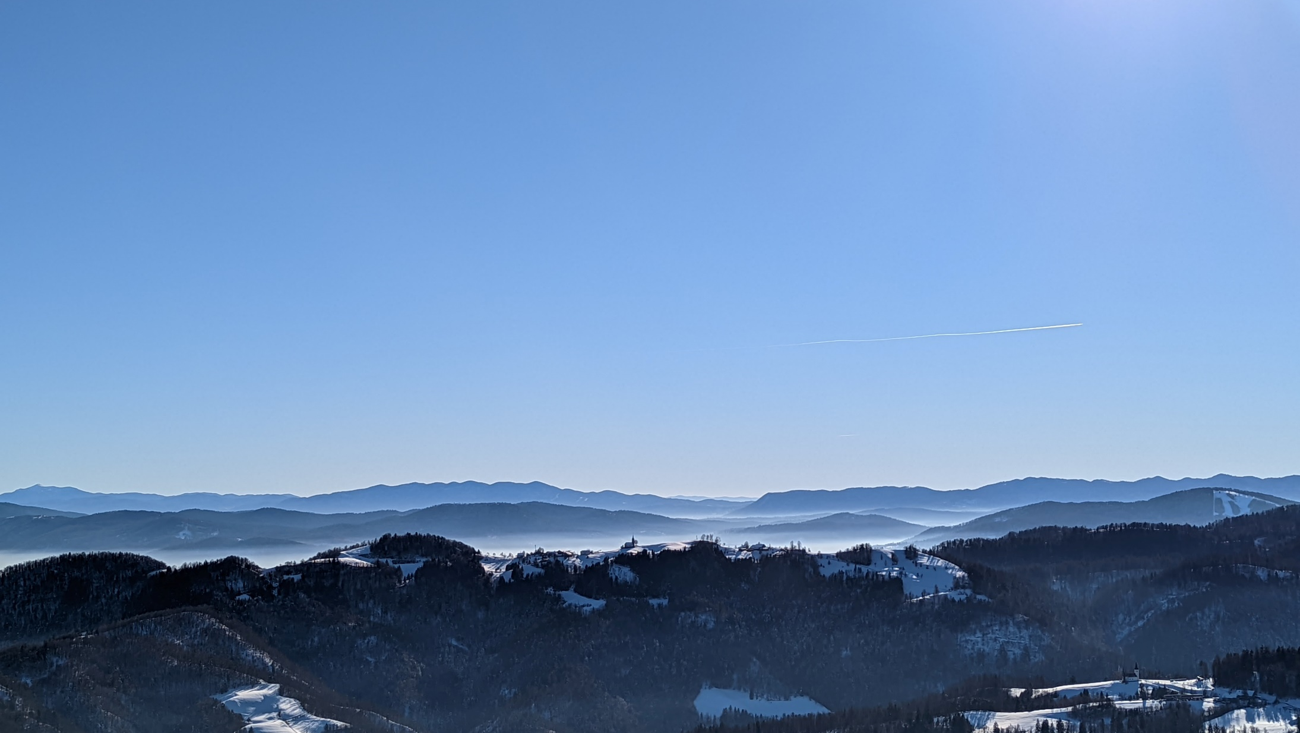
Horjul municipality
Spatial planning for flood protection
Arthur Guillot – Le Goff
University of Ljubljana – Semester of Autumn 2021

Slide 2
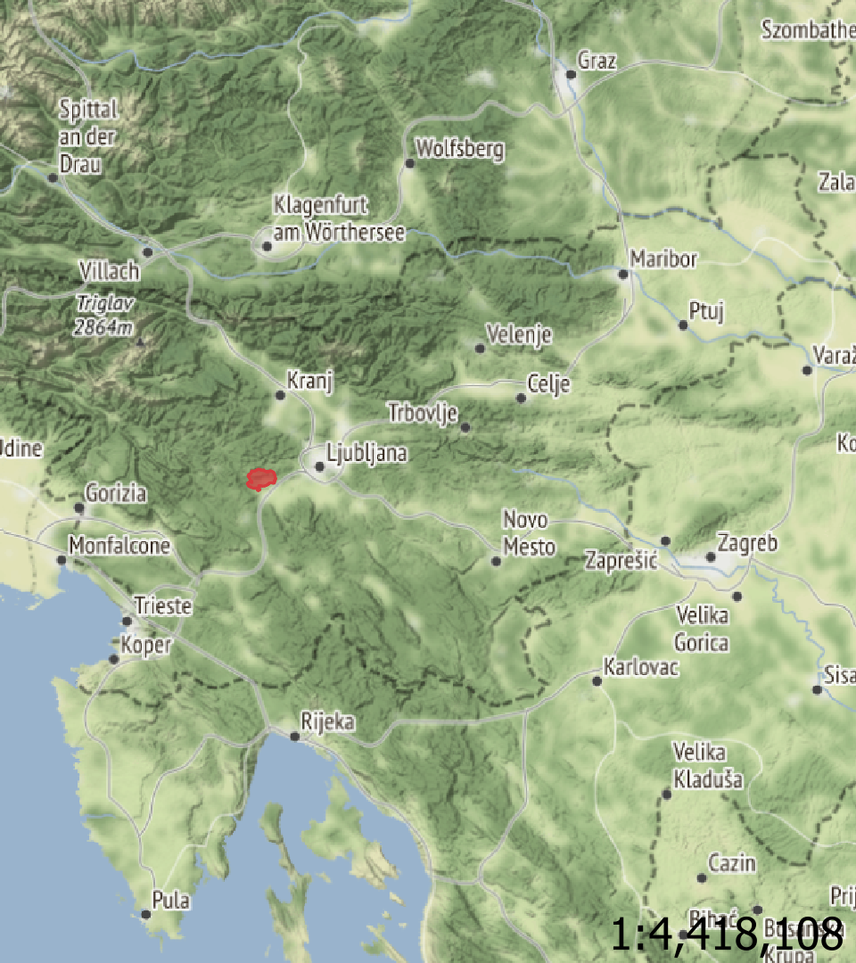
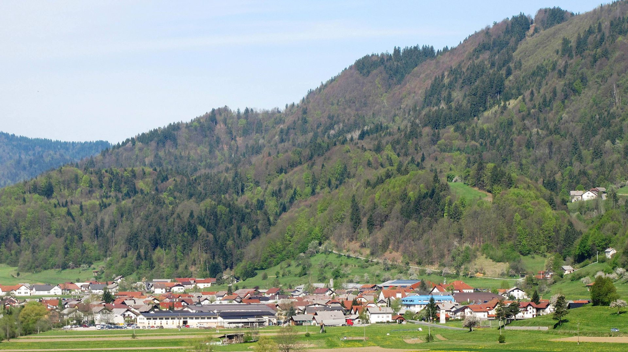
Horjul municipality
Population : 2985 inhabitants
Area : 32,5 m²
Density : 92 inhabitants/m²
15 km from Ljubljana

Slide 3
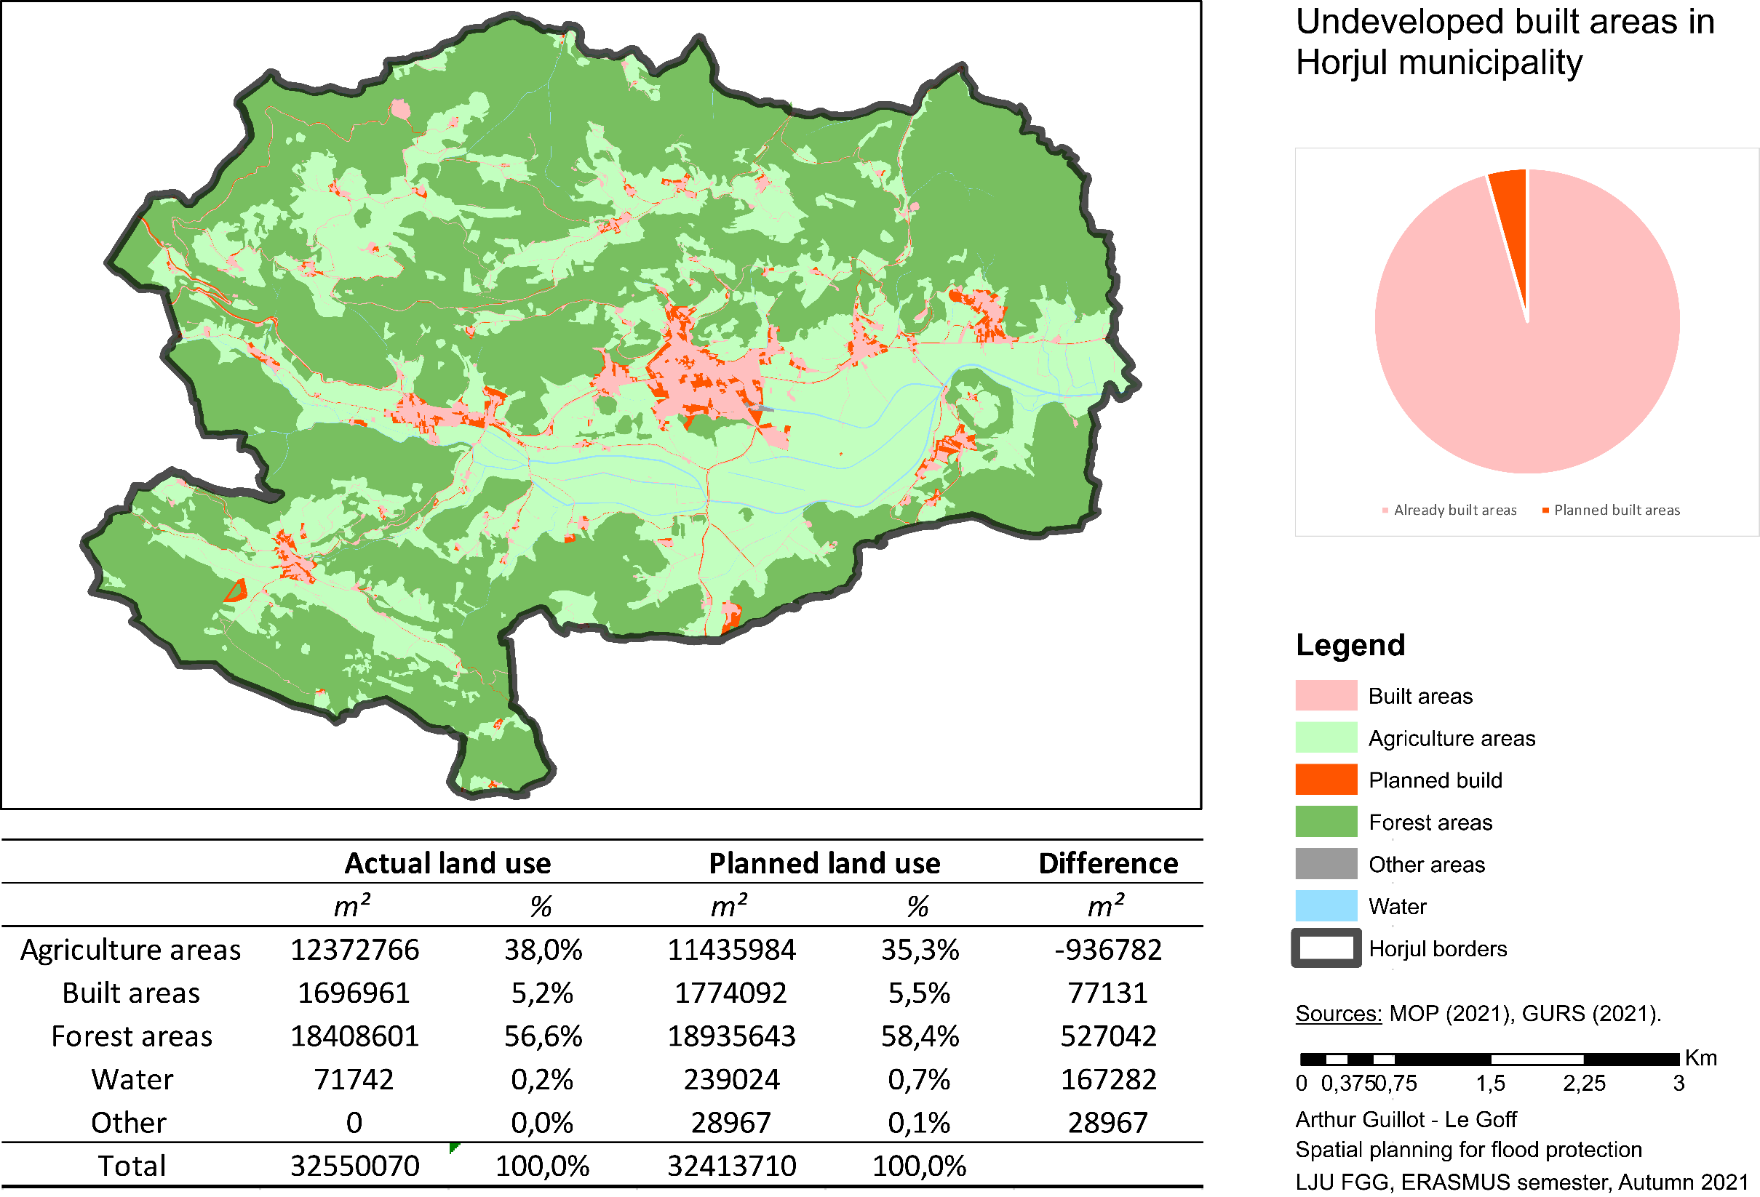

Slide 4
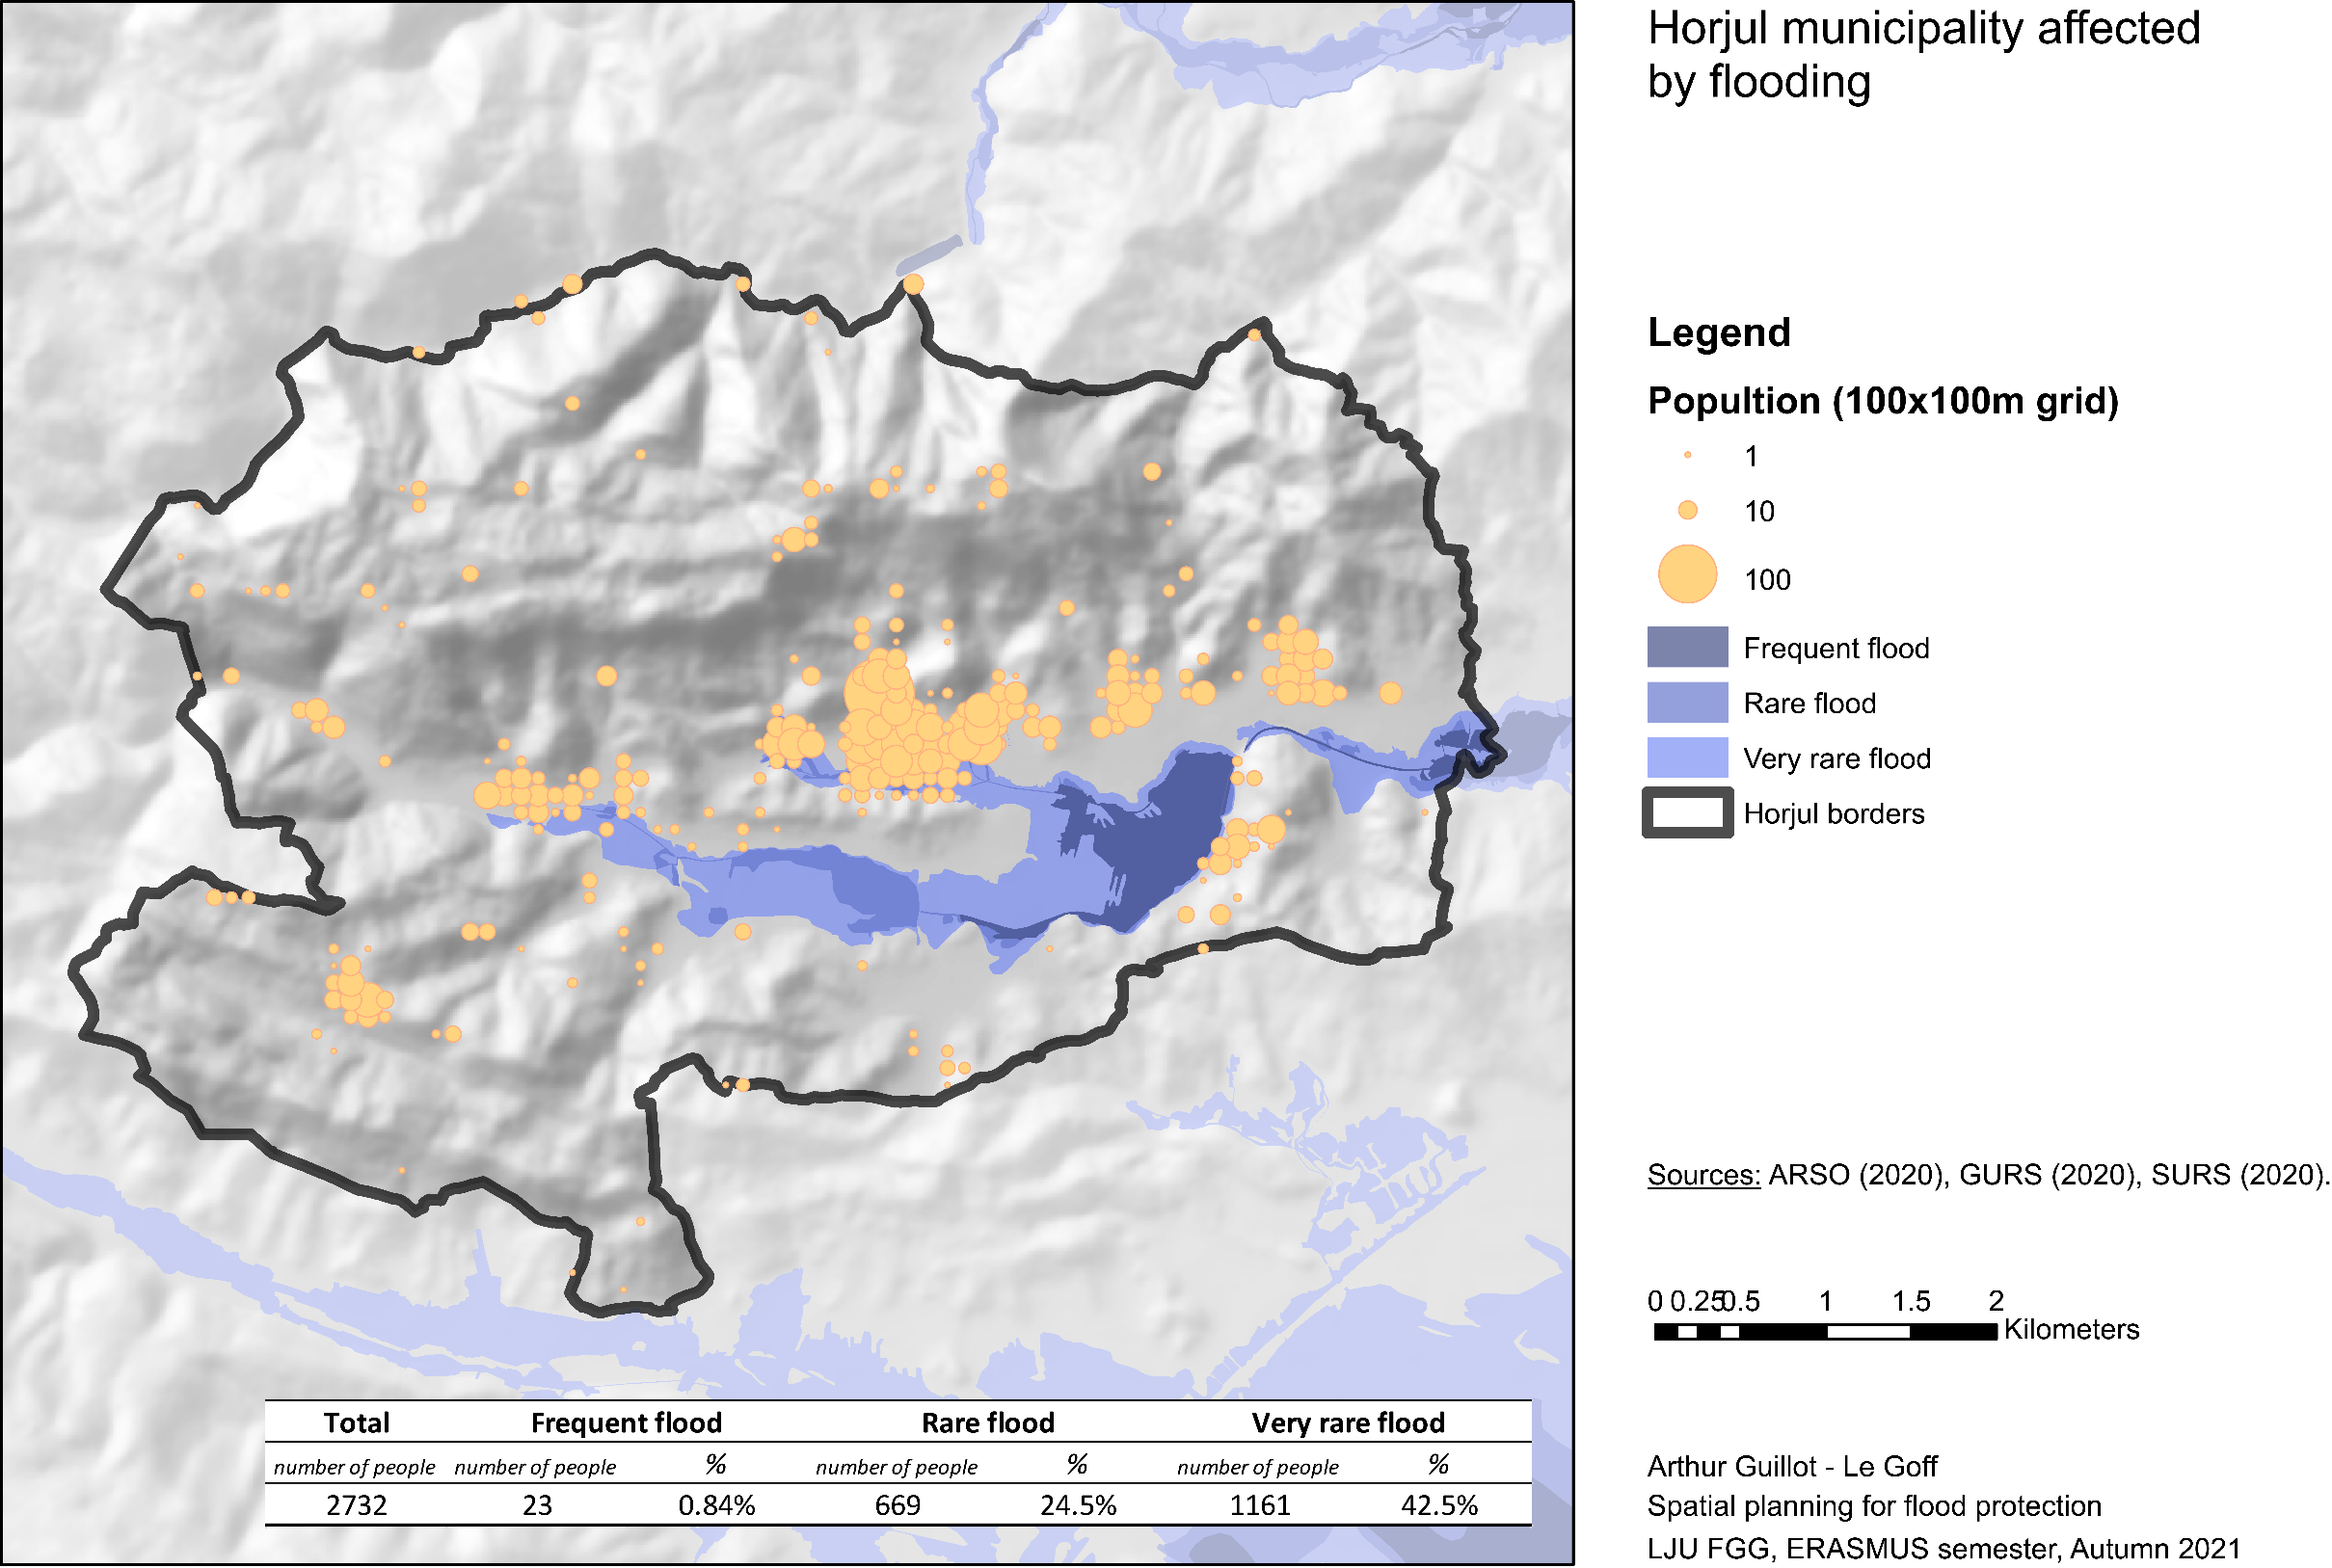

Slide 5
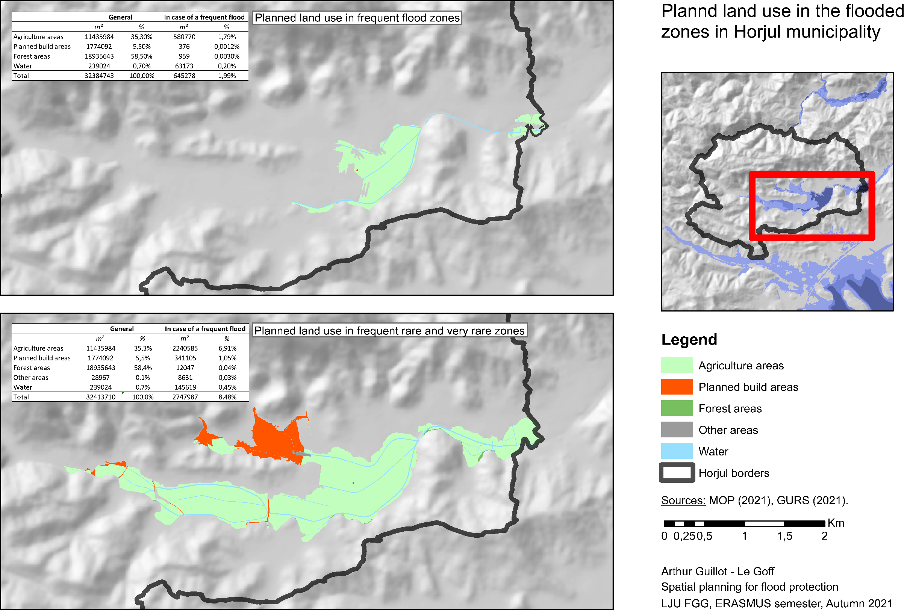

Slide 6
